Slide 1
Apache Pulsar
Alex Carvalho

Slide 2
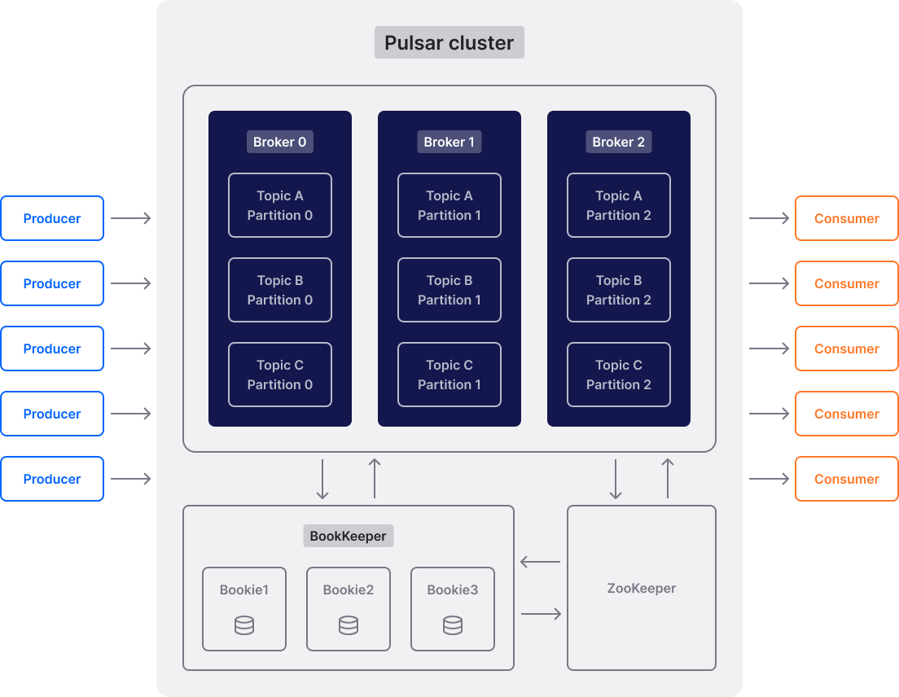
Architecture

Slide 3
Comparisons
Feature | Apache Kafka | Apache Pulsar
Programming Languages | 17 supported | 6 supported
Stack Overflow Questions | 33,281 questions | 358 questions
Connectors | 400+ open source | ~20 connectors
Multi-tenancy | Limited support | Native, built-in
Geo-replication | Needs MirrorMaker | Built-in
Schema Registry | Separate component | Built-in
Message consumption model | Pull | Push

Slide 4
Benchmark
Do yourself.

Slide 5
Trade-offs
✅ Pros
Decoupled Architecture
Native multi-tenancy
Built-in tired-storage
Unified Queue and Streaming models
Built-in geo-replication
Pulsar Functions
Schema integrated
Persistent and in memory topics
❌ Cons
Operational Complexity (Broker, Bookkeeper, ZooKeeper)
Small ecosystem compared with Kafka
Higher latency baseline
Few cloud offers (StreamNative, IBM Astra Streaming,)

Slide 6


Slide 7


